Slide 2
1
2
3
N
. . .

Slide 3
Z₂
3
. . .
Z₃
3
. . .
Z₄
3
. . .

Slide 4
3
Z₂
Sweep
3

Slide 5
3
Z₃
Sweep
3

Slide 6
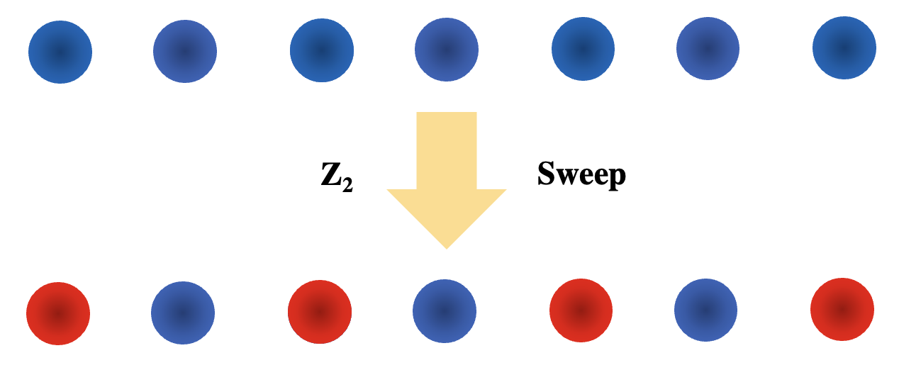
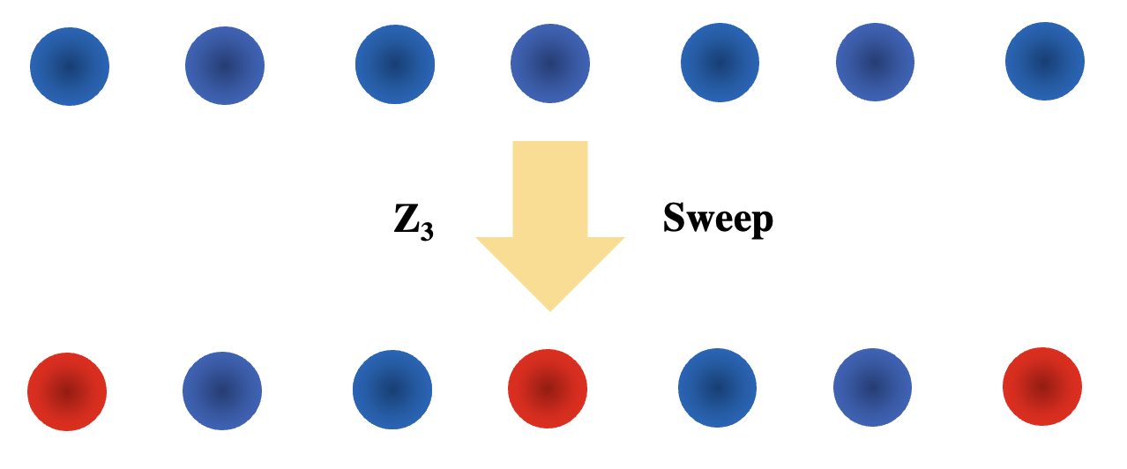

Slide 7
1
2
3
. . .
N
a

Slide 8
Optical
Tweezers
1
2
3
. . .
N
a
a
Driving
Laser

Slide 9
1
2
3
. . .
N
a
a

Slide 10
ZXCJK,L.;’\’§
R_{B}
1
2
3
a
a

Slide 11
R_{B}
1
2
3
a
a

Slide 12
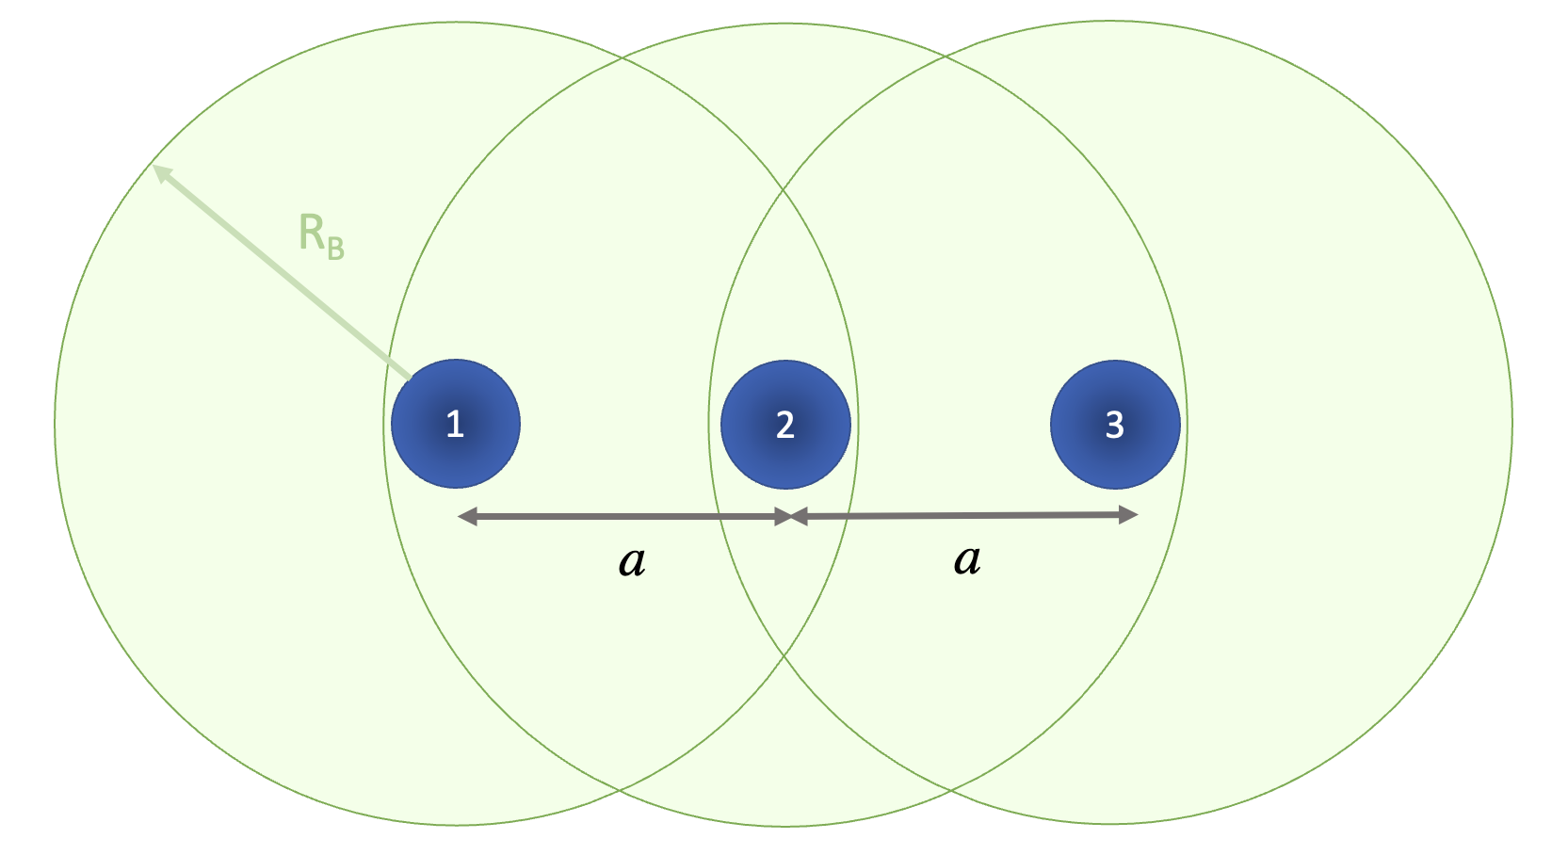
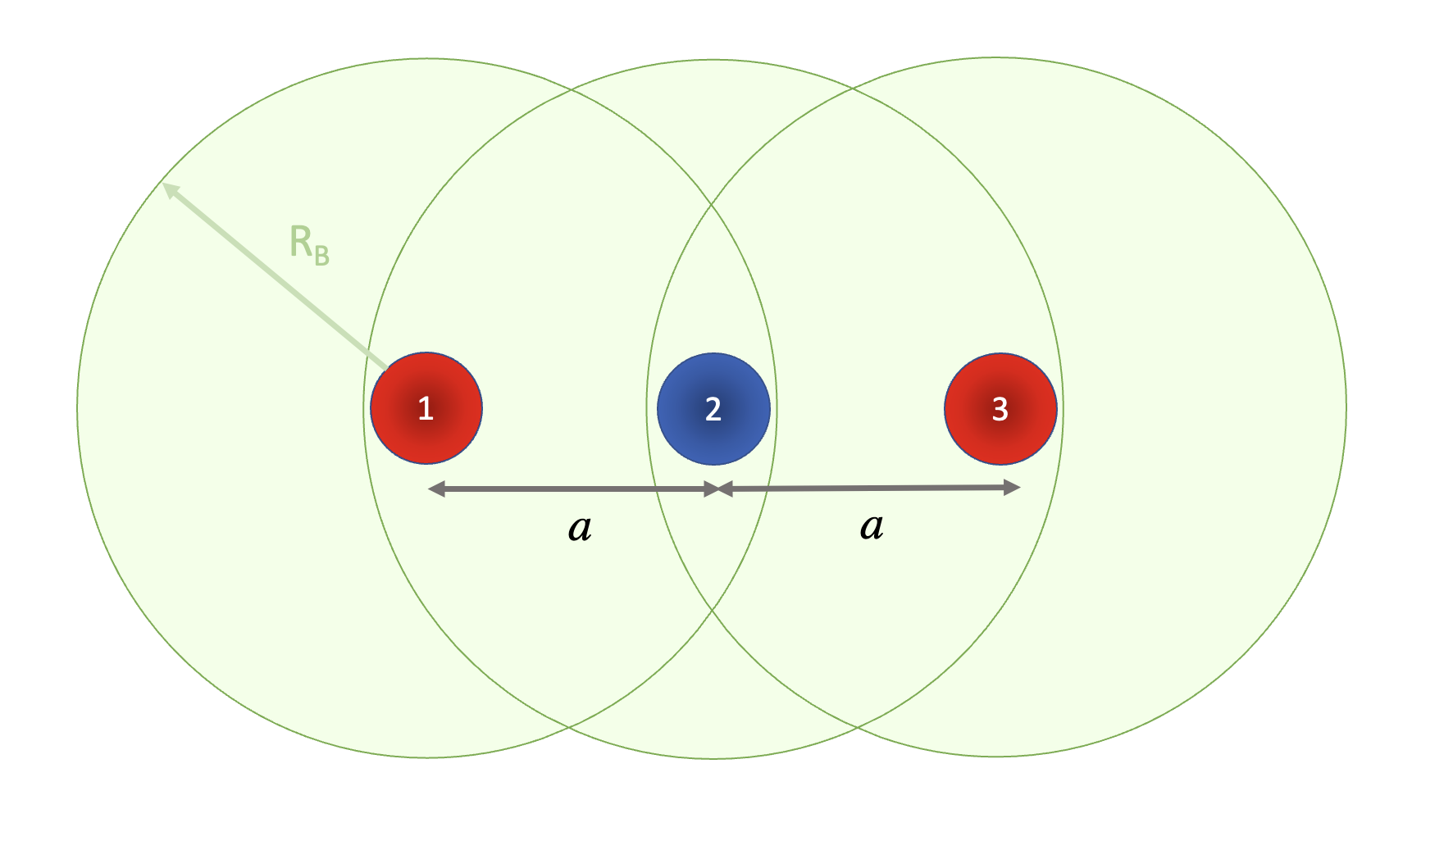
sweep

Slide 13
1
2
3
a
a

